Slide 1


Doctor Fee Prediction
Making it easy for everyone

Slide 2
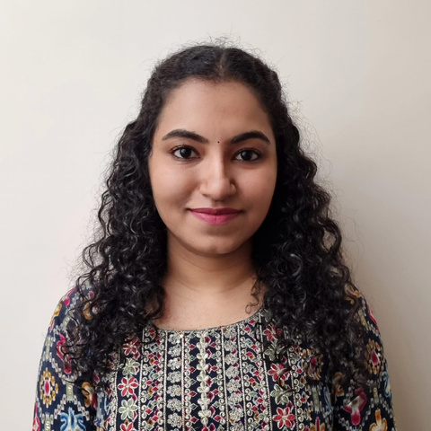
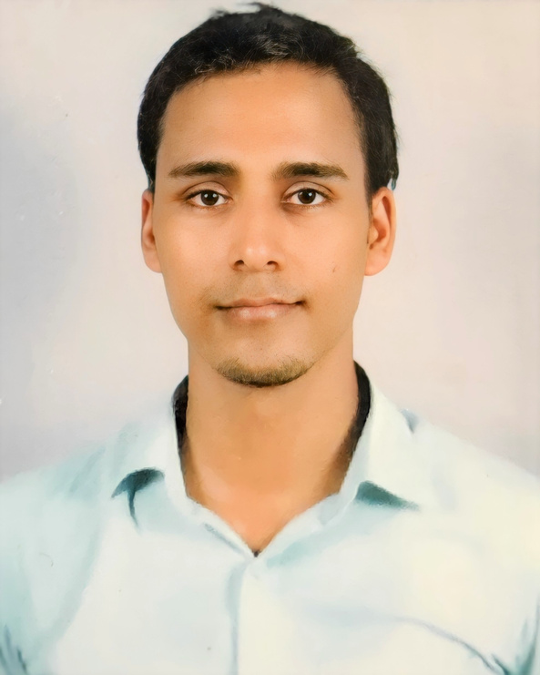

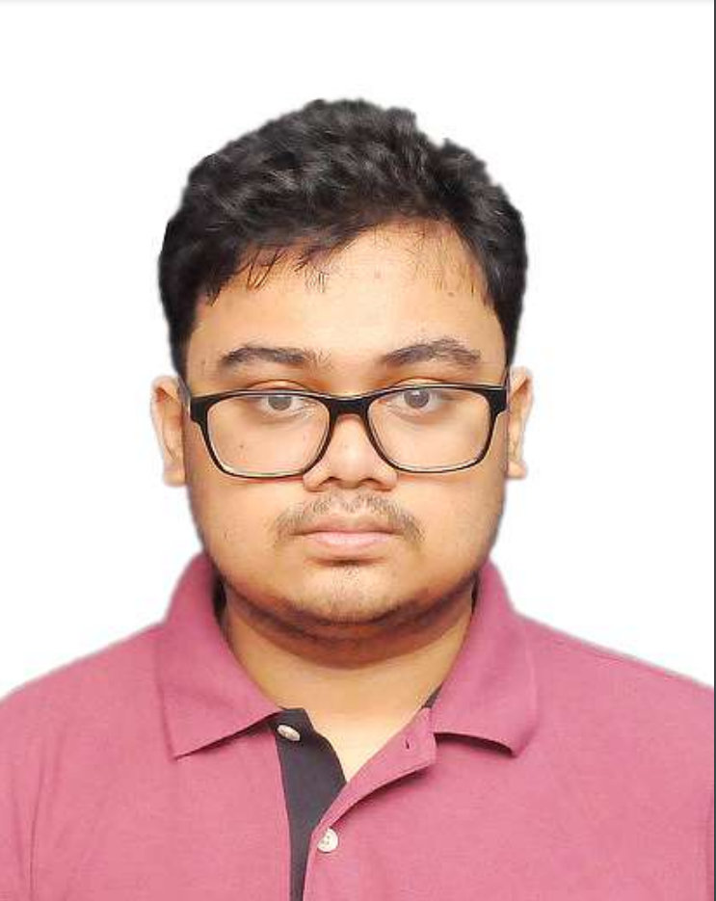


SANNIDHI R SHETTY
Meet the Team
DIPESH BHATT
DEBANKIT DEY
ANKIT PAL

Slide 3




Problem
The determination of consultation fees can vary significantly based on factors such as the doctor's experience, specialization, location, and facility type. As a result, patients often face uncertainty and difficulty in assessing the approximate cost of a doctor's visit.
Lack of access
Costly
Inconvenience

Slide 4

Solutions
By developing an ML model to predict consultation fees, we can address this issue by providing patients with a reliable tool to estimate the expected fees before their appointment.
With this information, patients can make better-informed decisions, plan their healthcare expenses more effectively, and have a clearer understanding of the financial implications associated with different healthcare providers.
By analyzing the contributing factors and their impact on consultation fees, organizations can optimize their pricing strategies, improve resource allocation, and enhance overall cost management.
Accessibility |  | Convenience |  | Cost-effective

Slide 5
Name of the doctor
Objective
Speciality of doctor
In order to serve the mentioned purpose the objective of this project involves
Degree type
Total year of experience
Location of clinic
Scrape the all types of doctor’s data from online medical consultancy booking site Practo using python library called Beautifulsoup (or similar) and collect information in the given format -
City of clininc
dp_score- Doctor Patient score
npv - No. of people vote
Consultation fee at clinic

Slide 6


Project Execution Roadmap
A look at how we have achieved this objective
Data Collection
Data Cleaning
ML Models
Web Page
EDA
Web Scraping using BeautifulSoup and Selenium
Using Numpy and Pandas Libraries
Using Numpy, Pandas, Matplotlib and Seaborn
Linear Regression Decision Tree, Random Forest
Created using Python Flask

Slide 7

City Wise Analysis of Doctors
According to the Practo Highest number of Doctors present in Bangalore

Slide 8
Most Common Degrees
600
400
X-Axis - Degree Type
Y-Axis - Count of Degrees
200
MBBS, MD and BDS are the Highest in Number
0
MBBS, MD
BDS
MBBS, MS
BDS, MDS
MBBS, DNB

Slide 9
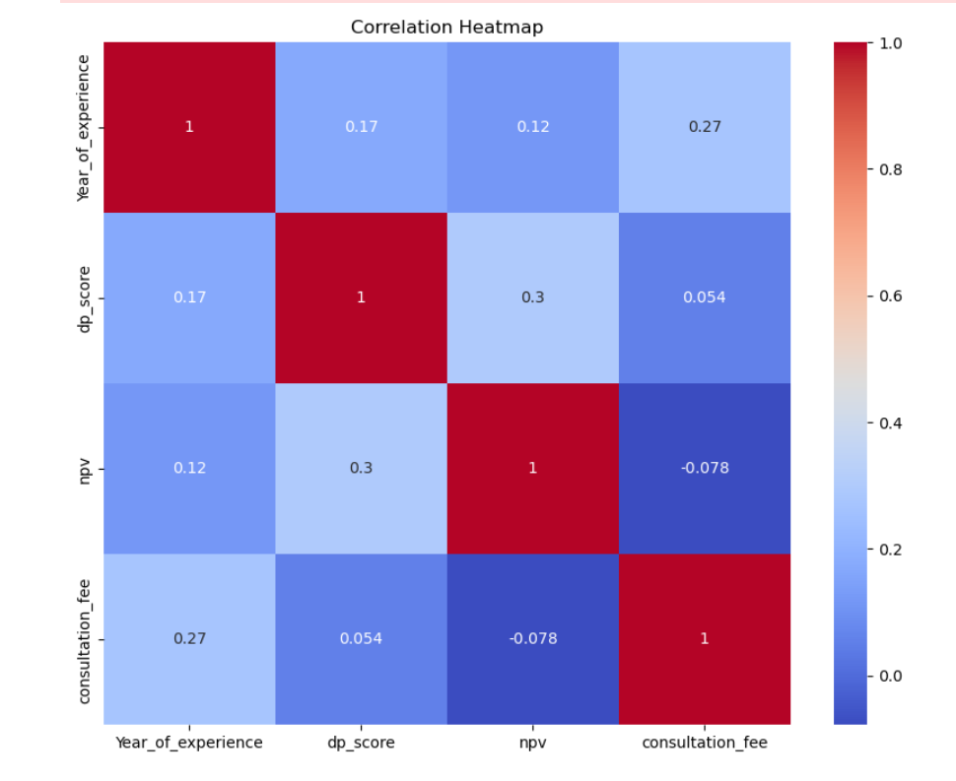
Correlation between different variables

Slide 10
Count of Doctors in different Specialties
Most number of doctors belongs to these 3 specialties
• Dentist
• Gynecologist
•Pediatrician

Slide 11


Slide 12
Average Years of Experience

Slide 13
ML Models
MSE = 71364.452
RMSE = 267.1412
r2_score = 0.358
MSE - 45822.6929
RMSE - 214.0623
r2_score - 0.5928
Decision Tree Regressor
GradientBoostingRegressor
Linear Regression
Random Forest Regressor
Support Vector Regression
MSE – 5.29e+26
RMSE – 2.30e+13
r2_score = -4.7
MSE = 39502.89
RMSE = 198.75
r2_score = 0.64
MSE = 89208.35
RMSE = 298.67
r2_score = 0.207

Slide 14
ML Models
MSE - 42620.89
RMSE – 206.44
r2_score - 0.621
MSE - 64304.594
RMSE - 253.5835
r2_score - 0.42865
Lasso Regression
AdaBoost Regressor
Ridge Regression
XGBoost model
MSE – 53626.03
RMSE - 231.5697
r2_score - 0.5235
MSE - 43908.5765
RMSE – 209.54 r2_score - 0.6098

Slide 15
Training Data Set
Model Selection
Hyperparameter tuning using GridSearchCV
RandomForest With optimized Hyperparameters
Lasso With optimized Hyperparameters
Ridge With optimized Hyperparameters
Final Ensembled Model (using Weighted voting)

Slide 16
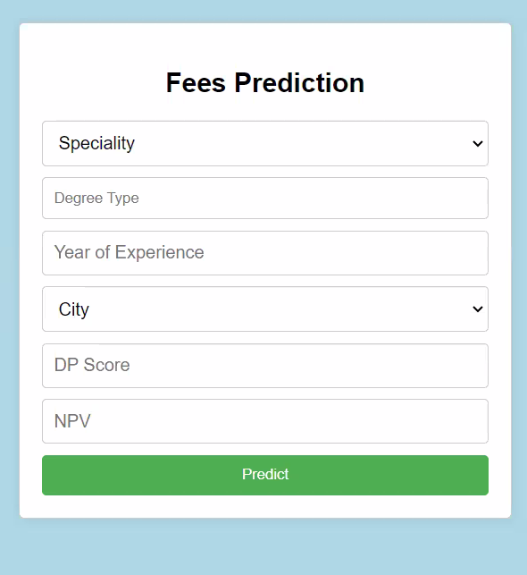

RESULTS
The consultation fees can be predicted by a user using this Interface. The features are to be entered and the consultation fees is calculated.
FEATURES
speciality_of_doctor
degree_type
year_of_experiance
city
dp_score
npv
PREDICTED CONSULTATION FEE
The predicted price is -

Slide 17
Thank
you!

